Slide 1
AI assisted Testing
- Rohan Patil

Slide 2
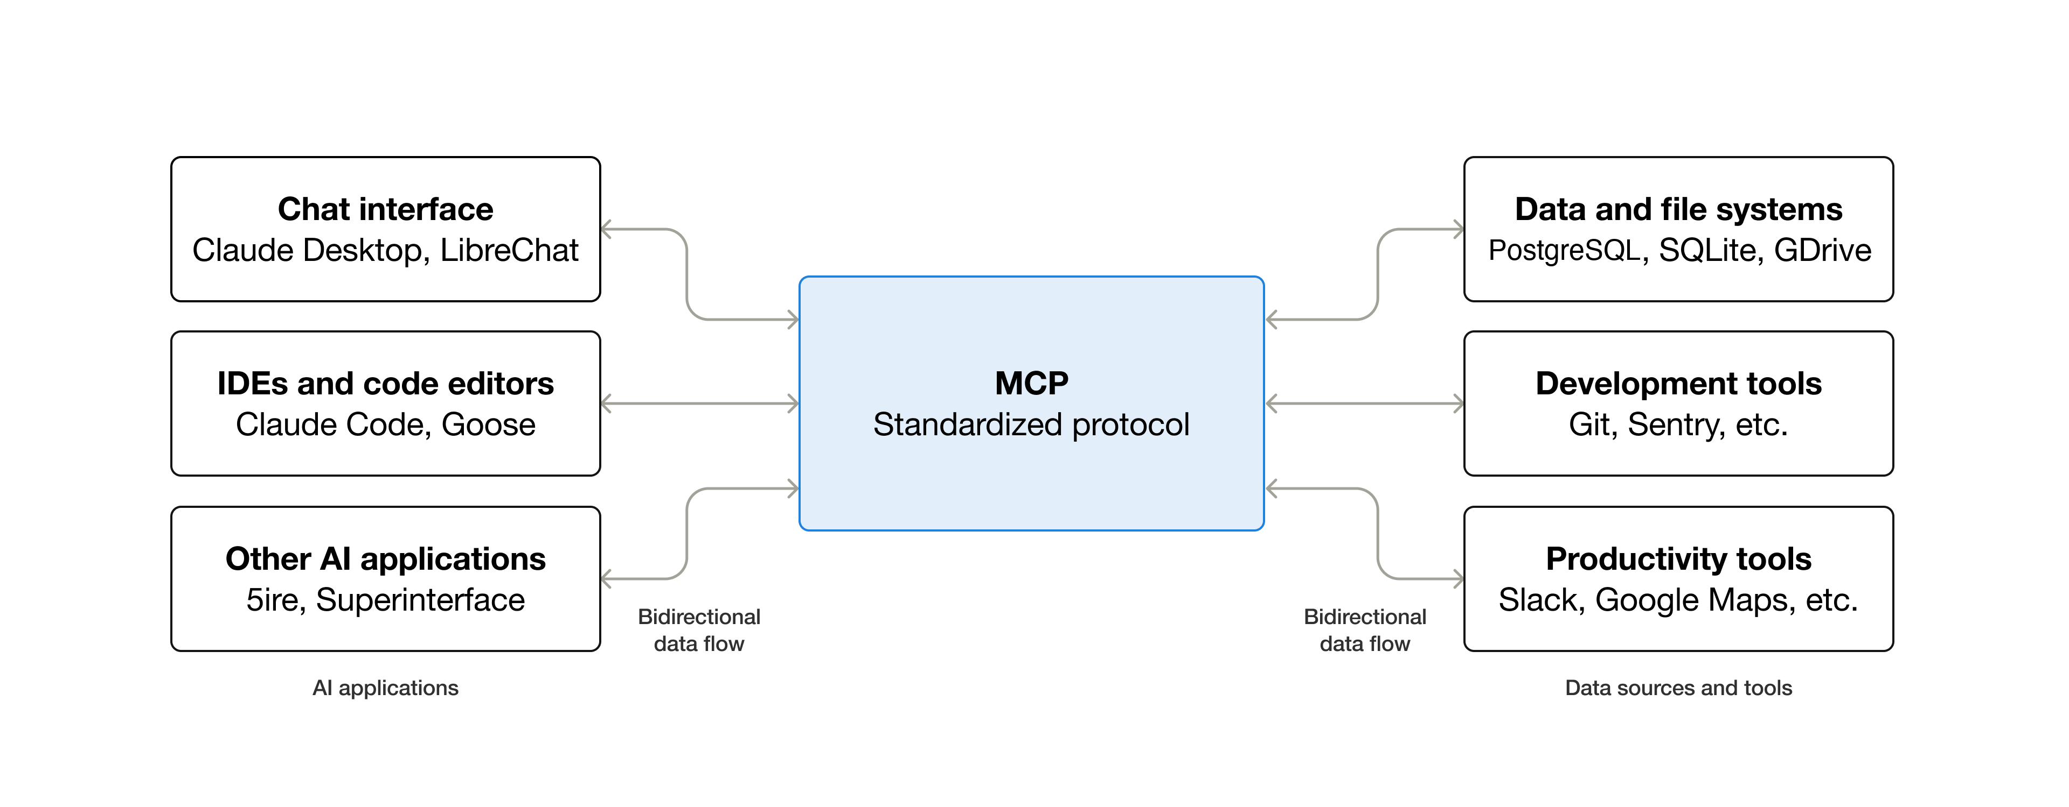
MCP
USB-C port for AI Applications
Standardized way to connect AI apps to external Systems

Slide 3
Process
AI talks to MCP
MCP uses Playwright
Playwright drives your web app

Slide 4
Agentic Testing Steps
Plan
Generate
Heal

Slide 5
3 Agents
🎭 Planner explores the app and produces a Markdown Test Plan
🎭 Generator transforms the Markdown plan into the Playwright Test files
🎭 Healer executes the test suite and repairs failing tests
https://playwright.dev/docs/test-agents

Slide 6
🎭 Planner
Planner agent explores the app, produces test plan for userflows & scenarios
Input:
  prompt (Generate a test plan for scenario)
  PRD doc for context

Slide 7
🎭 Generator
Uses the Markdown plan to produce executable Playwright Tests.
It verifies selectors and assertions live as it performs the scenarios.
Input
  Markdown test plan.md file
  Prompt : Generate tests for scenario #1

Slide 8
🎭 Healer
Replays failed tests.
Inspects the current UI to locate equivalent elements or flows
Suggests a Patch ( locator updates, wait adjustments )
Reruns the test until it passes
Input
  Heal this failing test (test name) or Fix the test
  Add the failed test file to chat context.

Slide 9
Demo

Slide 10
Next Steps….

Slide 11
Playwright CLI & Skills
AI agents often hallucinate Playwright CLI commands, leading to errors and wasted resources.
The Playwright CLI Skill solves this by teaching Goose exactly how and when to use Playwright's CLI — no guesswork, no wasted tokens
npm install -g @playwright/cli@latest
In project directory
npx skills add https://github.com/microsoft/playwright-cli --skill playwright-cli

